Slide 1

Air Quality Analysis Across U.S. Regions Using R
Final Project: Practical Statistics & Programming Using R
Presenter: Soli Evans
Dataset: EPA Daily AQI by CBSA (2024)

Slide 2
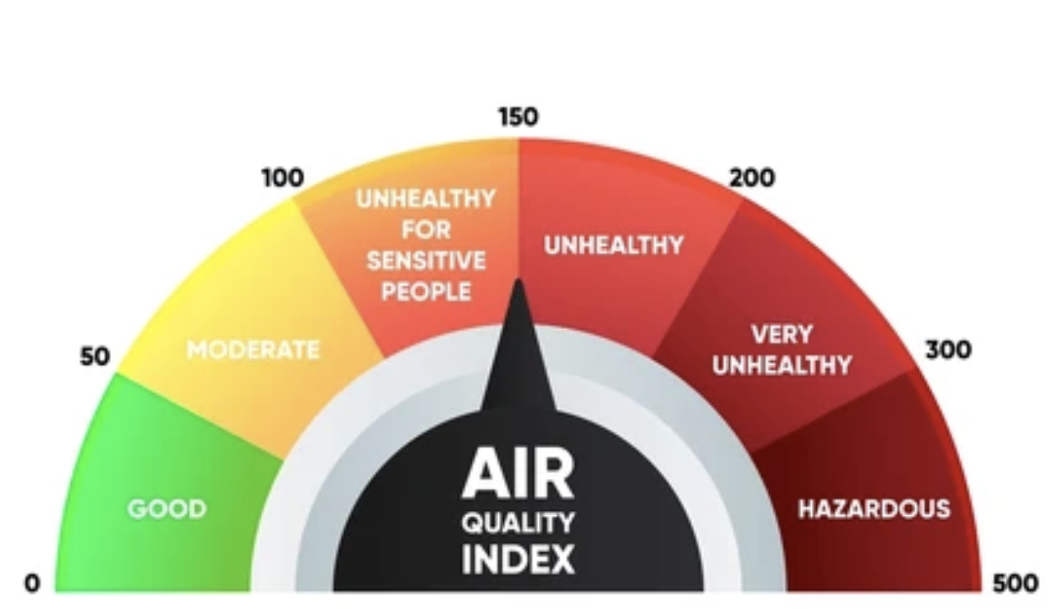
Background & Importance
Air Quality Index (AQI) is a standardized measure used to communicate daily air pollution levels.
Poor air quality is associated with increased respiratory symptoms, cardiovascular disease, and hospital admissions.
Understanding regional variation and seasonal trends in AQI helps inform public health planning and environmental policy.

Slide 3
Dataset Overview
Dataset: EPA Daily AQI by CBSA (2024)
Observations: 171,648 rows
Key Variables: AQI, Category, Pollutant, CBSA, State, Region, Date, Month
Source: U.S. Environmental Protection Agency (EPA), Daily Air Quality Data

Slide 4
Study Aims
Aim 1 (Statistical): Test whether mean AQI significantly differs across U.S. regions.
Aim 2 (Machine Learning): Build classification models (Decision Tree and Random Forest) to predict AQI category based on region, pollutant, and seasonal patterns.

Slide 5
Data Cleaning & Preparation
Removed malformed header and parsed CSV structure
Converted date, numeric, and factor fields
Extracted state from CBSA using string operations
Created derived variables: Region, Month, and AQI_Class
Removed invalid or missing values
Validated category definitions against EPA coding

Slide 6
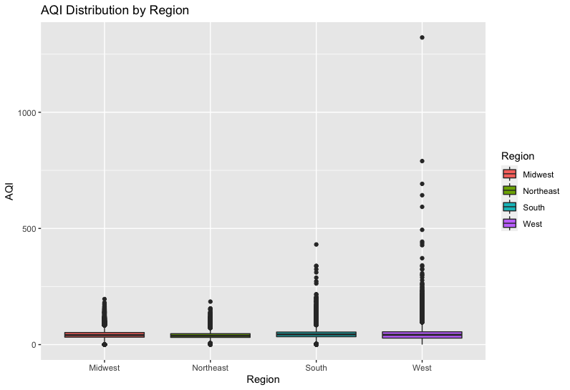
Descriptive Statistics: AQI Summary
AQI Summary (All Regions):
Mean: 43.75
Median: 42
Range: 0 to 1322
Highest variability observed in Western region due to wildfire events.

Slide 7
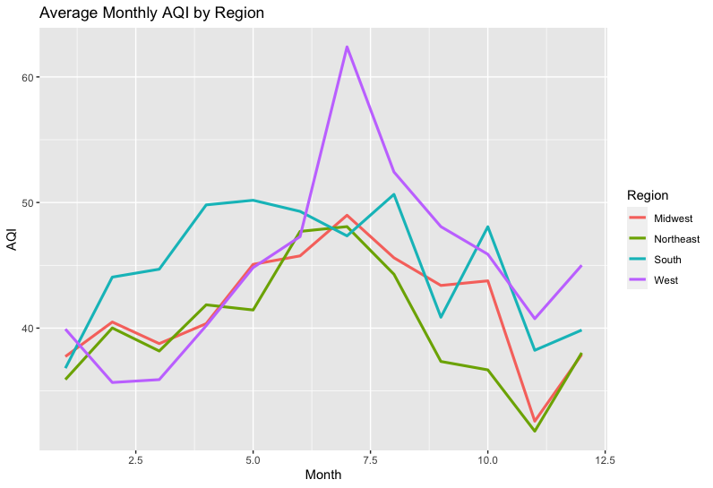
Seasonal Trends
AQI peaks during summer months across all regions.
Western region experiences the sharpest midsummer spike.
Winter months generally show cleaner air and lower AQI values.

Slide 8
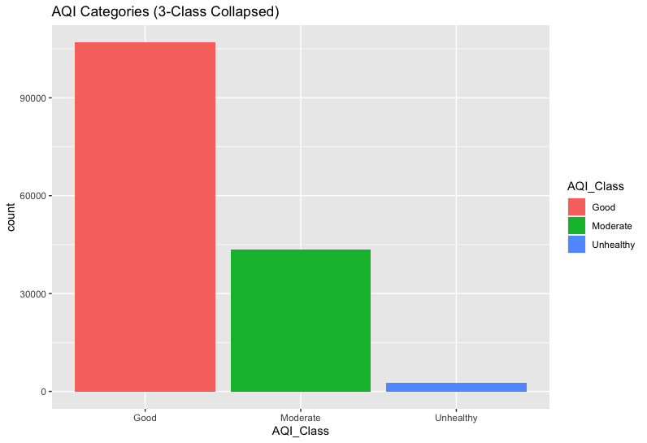
AQI Categories
Majority of days fall within the Good category.
Moderate days represent a substantial portion of the dataset.
Unhealthy days occur infrequently but are important to analyze.
Class imbalance impacts model performance considerations.

Slide 9
Inferential Statistics
One-Way ANOVA: Significant differences in mean AQI across regions (F = 384.3, p < .001)
Tukey HSD Post Hoc:
South & West have significantly higher AQI than Northeast & Midwest.
Two-Way ANOVA (Region × Month): Region, Month, and their interaction were all significant (p < .001), indicating seasonal trends differ across regions.

Slide 10
Machine Learning Approach
Outcome Variable: AQI_Class (Good, Moderate, Unhealthy) Predictors: AQI, Region, State, Month, Pollutant
Methods Used:
Decision Tree (rpart)
Random Forest (caret + randomForest)
Train/Test Split: 80/20, stratified by AQI class

Slide 11
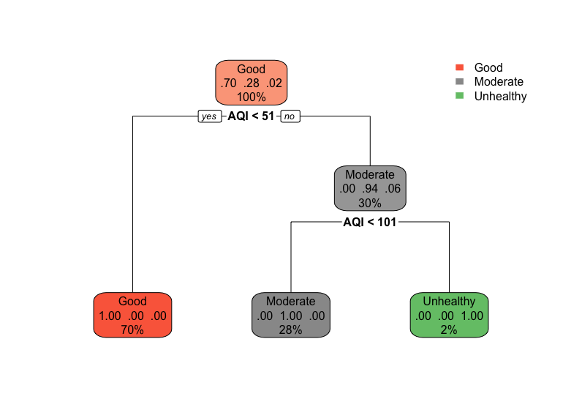
Decision Tree Results
Accuracy: 100% The model perfectly classified all AQI categories, mirroring EPA-defined AQI thresholds.
Key Splits:
AQI < 51 → Good
AQI 51–100 → Moderate
AQI ≥ 101 → Unhealthy

Slide 12
Random Forest Results
Random Forest Performance:
Near-perfect accuracy
Robust to noise and variability
Confirmed importance of key predictors
Top Predictors:
AQI
Month
Region
Pollutant

Slide 13
Interpretation & Key Insights
The South and West experience higher pollution levels overall.
Seasonal variation is significant, with summer showing the poorest air quality.
Machine learning models validated the deterministic nature of EPA AQI categories.
Results support environmental health literature on pollutant trends and regional disparities.

Slide 14
Limitations
AQI categories are deterministic based on numerical thresholds, contributing to perfect classification.
Dataset lacks meteorological variables such as humidity and wind.
Region assignment is an approximation based on state boundaries.
Outliers from extreme wildfire events inflate AQI values.

Slide 15
Final Conclusions
AQI differs significantly across U.S. regions and seasons.
Western and Southern states show highest pollution levels.
Machine learning models performed exceptionally well.
Findings may inform environmental monitoring, policy planning, and public health response strategies.

Slide 16
References
Di, Q., Dai, L., Wang, Y., Zanobetti, A., Choirat, C., Schwartz, J. D., & Dominici, F. (2017). Association of short-term exposure to air pollution with mortality in older adults. JAMA, 318(24), 2446–2456. https://doi.org/10.1001/jama.2017.17923
Dominici, F., Peng, R. D., & Barr, C. D. (2019). Air pollution and health: A global perspective. Annual Review of Public Health, 40, 45–67. https://doi.org/10.1146/annurev-publhealth-040617-013638
Fiore, A. M., Naik, V., & Leibensperger, E. M. (2015). Air quality and climate connections. Journal of the Air & Waste Management Association, 65(6), 645–685. https://doi.org/10.1080/10962247.2015.1040526
Reid, C. E., Brauer, M., Johnston, F. H., Jerrett, M., Balmes, J. R., & Elliott, C. T. (2019). Critical review of health impacts of wildfire smoke exposure. Environmental Health Perspectives, 124(9), 1334–1343. https://doi.org/10.1289/ehp9934
Samet, J. M., Gruskin, S., & Dominici, F. (2020). Fine particulate matter and public health: A global challenge. New England Journal of Medicine, 382(7), 691–693. https://doi.org/10.1056/NEJMp1914250
United States Environmental Protection Agency. (2024). Air Quality Index (AQI) basics. https://www.airnow.gov/aqi/aqi-basics/
U.S. Environmental Protection Agency. (2024). Download daily data: Outdoor air quality data. https://www.epa.gov/outdoor-air-quality-data/download-daily-data

Slide 17
Thank You!
Questions?

